Slide 1
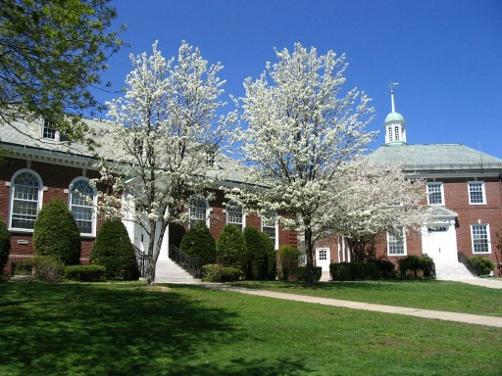
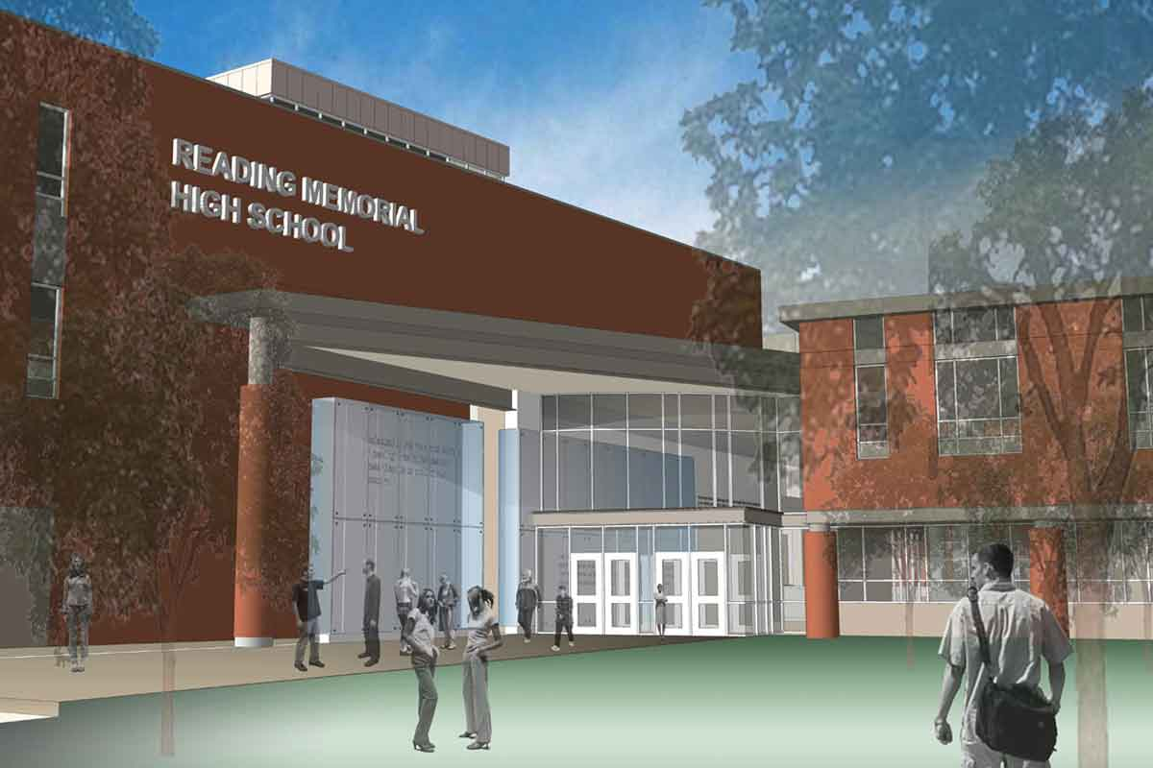
Town of Reading
For the PAC Audience
use RPS GUEST
WiFi password: none
Annual Town Meeting
April 25, 2022

Slide 2
2022 Annual Town Meeting
Article 4
Pages
Adds, removes or changes items in the FY22-32 Capital Improvements Program – does not authorize any funding for these items:
FY22 General Fund: $145,000 net changes
$110,000 Parking kiosks (4)
$ 15,000 Remote Access multi factor authentication
$ 20,000 Internal segmentation firewall
FY23 General Fund: +$117,000 net changes
$ 12,000 RISE playground design (new)
$ 15,000 Town buildings doors & windows (new)
$ 5,000 Ambulance equipment
-$ 100,000 Strout Ave improvements (objections at previous TM)
$ 185,000 DPW Snow Holder (increased $5k & moved up from FY26)

Slide 3
2022 Annual Town Meeting
Article 4 (continued)
Pages
FY24 General Fund: +$25,000 net changes
$ 163,000 ARC Flash Hazard Study
$ 120,000 RISE playground project (new)
$ 55,000 School carpet/flooring (new)
$ 225,000 DPW Loader (new, to replace Sicard for snow)
-$ 111,000 DPW Snow Prinoth (moved out to FY31)
$ 165,000 Blower unit for loader (new, in conjunction w/ Sicard replacement
$ 200,000 DPW Truck #11 (moved up from FY26)
-$ 200,000 DPW Truck #18 (moved out to FY26)
$ 20,000 School doors and windows (new)
-$ 12,000 Wood End ES water heater (done)
-$ 250,000 Coolidge MS roof design (moved to FY29)
-$ 150,000 Birch Meadow ES roof design (moved to FY29)
-$ 200,000 Birch Meadow ES site improvements (moved out to FY25)

Slide 4
2022 Annual Town Meeting
Article 4 (continued)
Pages
FY22 Enterprise Funds: +$550,000 in total
Water: +$400,000 Water main repairs (focus on Walker’s Brook)
Sewer:+$150,000 Additional funding for Downtown Sewer main work
FY23 Enterprise Funds: +$700,000 in total
Water: +$400,000 Water main repairs (Emerson)
Sewer:+$300,000 Memorial Park drainage lining project
FY24 Enterprise Funds: various changes made

Slide 5
2022 Annual Town Meeting
Article 5
Pages
Authorizes these changes to FY22 General Fund budget:
Line | Description | Decrease | Increase
B99 Benefits | Health Insurance Premiums -$650,000 OPEB allocation +$250,000 | $400,000
C99 Capital | As described in Article 4 |  | $145,000
E99 Vocational Education | Essex North -$30,000 | $30,000
F99 FINCOM Reserves | COVID Tests/Health Expense $80,000 Ladder Truck $67,000 |  | $147,000
G91 Admin Services Wages | Town Manager overlap $8,000 Town Manager termination pay $17,000 OPS Buybacks $17,000 (retirements) Tech Buybacks $7,000 (retirements) |  | $49,000

Slide 6
2022 Annual Town Meeting
Article 5
Pages
FY22 General Fund budget (continued):
Line | Description | Decrease | Increase
G91 – Admin Services Exp | Town Manager and Deputy Chief Screening processes $21,000 Fiber network repairs $6,000 |  | $27,000
H92 – Public Services Exp. | Housing Production Plan - Consulting Services $50,000 Town Owned Land Community Visioning Process $50,000 |  | $100,000
J91 – Public Safety Wages | Fire buybacks $75,000 (retirements) Fire OT $75,000 |  | $150,000
K93 – Public Safety Expenses | Public Health outsourced records $25,000 |  | $25,000

Slide 7
2022 Annual Town Meeting
Article 5
Pages
Authorizes these changes to FY22 Enterprise Fund budget:
Line | Description | Decrease | Increase
K92 Public Works Expenses | West/Woburn video detection processor$15,000 Electrical cabinet $40,000 |  | $55,000
K93 Snow & Ice | Estimate as of 3/10/22 |  | $200,000
 | Subtotals | $430,000 | $898,000
 | Net Operating Expenses |  | $468,000
 | From Free Cash |  | $468,000

Slide 8
2022 Annual Town Meeting
Article 5
Pages
Authorizes these changes to FY22 Enterprise Fund budget:
Line | Description | Decrease | Increase
W99 Water EF | Water main project $400,000 Fiber network repairs $6,000 Water Rate Study $13,000 |  | $419,000
S99 Sewer EF | Downtown Sewer project additional funding $150,000 Fiber network repairs $6,000 Sewer Rate Study $13,000 |  | $169,000
 | Subtotals |  | $588,000
 | Net Operating Expenses |  | $588,000
 | From Water EF Reserves From Sewer EF Reserves |  | $419,000 $169,000

Slide 9
2022 Annual Town Meeting
Article 6
Pages
Prior Year’s Bills – Not Applicable, recommend that this article be tabled.

Slide 10
2022 Annual Town Meeting
Article 7
Pages
Other Post Employment Benefits (OPEB)
Move appropriated funds to the OPEB Trust
$350,000 General fund ($100k + $250,000 approp. in Art. 5)
$ 85,000 Water Enterprise Fund
$ 23,000 Sewer Enterprise Fund
$ 10,500 Storm Water Enterprise Fd.
$468,500 in total (Orig. Approp. $218.5k + $250k from Art. 5)

Slide 11
2022 Annual Town Meeting
Article 8
Pages
Move 40R funds to Stabilization Fund
No funds received. Not Applicable, recommend that this article be tabled.

Slide 12
2022 Annual Town Meeting
Article 9
Pages
Authorizes Revolving Funds Annual Spending Limits and amends Section 6.5.2 of the General Bylaw:

Slide 13
2022 Annual Town Meeting
Article 9 continued
Pages
Authorizes Revolving Funds Annual Spending Limits
Fund | Balance | Annual
Conservation Consulting | $37,559 | $25,000
Inspections | $744,598 | $250,000
Public Health Clinics & Services | $30,706 | $25,000
Library Fines and Fees | $11,982 | $15,000
Mattera Cabin Operating | none | $10,000
Town Forest | none | $10,000

Slide 14
2022 Annual Town Meeting
Article 10
Pages
Affordable Housing Trust Fund Allocation Plan
Pursuant to Article 10 of the 2022 Annual Town Meeting, an Affordable Housing Trust Fund Allocation Plan for the Fiscal Year 2023 in accordance with the provisions of Chapter 140 of the Acts of 2001 is as follows:
Available Balance – Unrestricted Funds: $ 457,716
Available Balance – Restricted Funds $ 0
Unrestricted funds shall be used for the following purposes:
$10,000 or a maximum of 5% for administration of Affordable Housing
Remainder for constructing affordable housing (including loan and grant programs); or for maintaining and improving affordability of existing housing stock; or for the purchase of existing housing stock to add it to or maintain it as a part of the existing affordable housing inventory.

Slide 15
2022 Annual Town Meeting
Article 11
Pages
Addition of Section 6.5.7 of the General Bylaw by inserting new revolving fund and authorizes spending limit:

Slide 16
2022 Annual Town Meeting
Article 12
Pages
Authorize the Select Board to relocate a drainage easement at 104 Lilah Lane, Reading, Massachusetts by abandoning an existing drainage easement and accepting a new, equivalent drainage easement on the same property:
The Town currently has title and interest to a drainage easement over the property located at 104 Lilah Lane, Assessors Map 55, Parcel 30.
The residents are proposing a new pool and patio that will protrude in the existing easement.
The residents have requested the abandonment of a portion of the drainage easement.
The easement is occupied by an existing detention basin, and if approved, the resulting area is sufficient size to enable the Town to provide proper stormwater storage, maintenance or repair of the detention basin.
No additional utilities are proposed to occupy this easement in the future

Slide 17
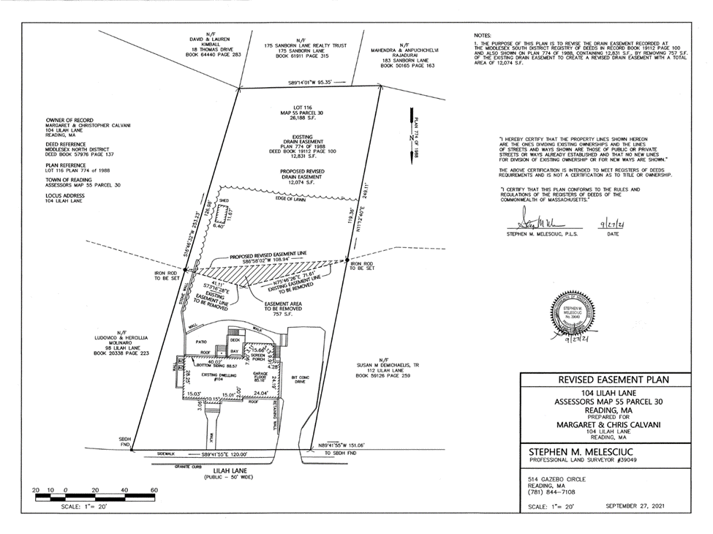
2022 Annual Town Meeting
Article 12 Continued
Pages

Slide 18
2022 Annual Town Meeting
Article 13
Pages
Authorize the Select Board to accept a water easement over a portion of Gazebo Circle adjacent to the existing Bear Hill water tank.
The easement will allow the Town the rights to install and maintain a new water connection to the Town distribution system.
The connection is hydraulically necessary as part of the previously approved water booster station.
The Board of Trustees of the Summit Village will be gifting this easement to the Town.

Slide 19
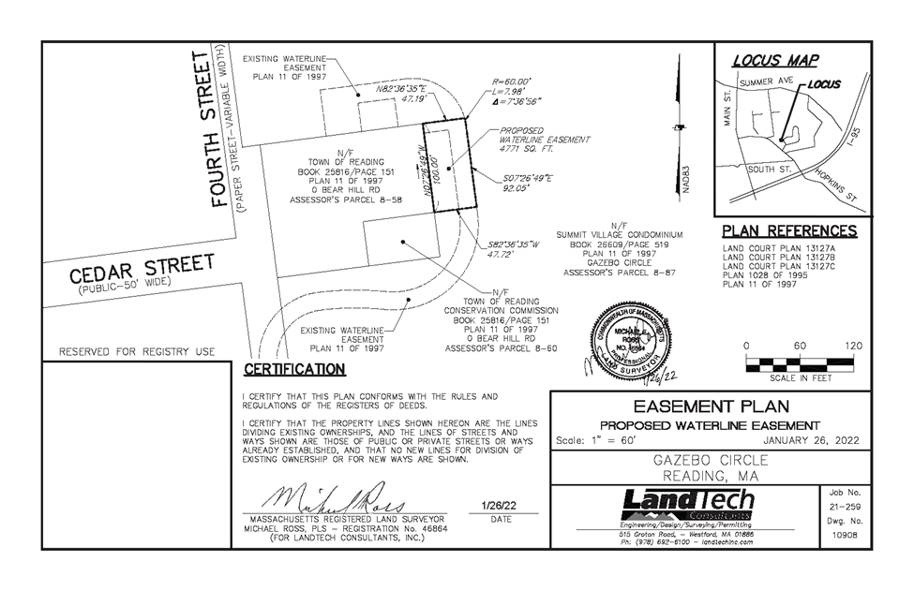
2022 Annual Town Meeting
Article 13 Continued
Pages

Slide 20
2022 Annual Town Meeting
Article 14
Pages
Authorize the Select Board to accept a water easement over a portion of 369 Main Street, currently being operated by Jiffy Lube
The easement will allow the Town the rights to install and maintain a new water main which will connect Main Street and Ash Street.
The easement will modify a pre-existing sewer easement to allow for water main access as well.
The connection is hydraulically necessary and will eliminate a water main crossing under the railroad.
This water main installation is part of the previously approved Downtown Water Main improvements.

Slide 21
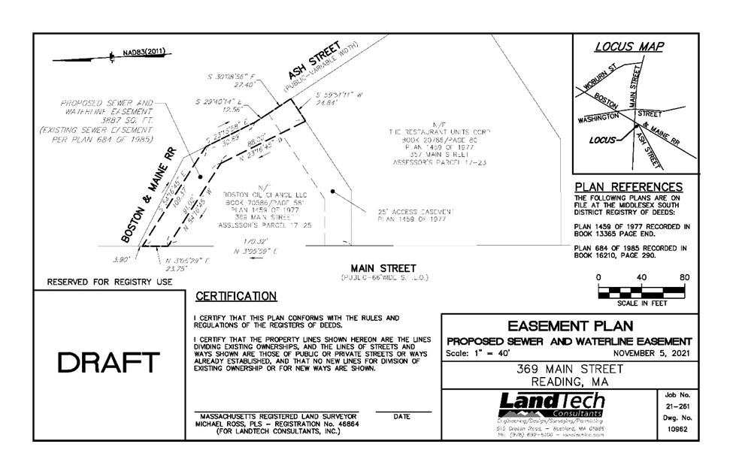
2022 Annual Town Meeting
Article 14 Continued
Pages

Slide 22
2022 Annual Town Meeting
Article 15
Pages
Amend Downtown Smart Growth Zoning
Presentation and separate pre-recording by CPDC

Slide 23
2022 Annual Town Meeting
Article 16
Pages
Authorize RMLD Land Purchase:
The Article was originally to authorize the purchase of a property in Wilmington for a new substation. However, the seller did not agree. RMLD is looking into purchasing a similar property across the street from the original property. This item might be addressed at a Special Town Meeting, later. Recommend that this article be tabled.

Slide 24
2022 Annual Town Meeting
Article 17
Chapter 90 Allocation
Page
Authorize appropriation by borrowing in anticipation of Ch. 90 and accept Ch.90 at whatever level is ultimately available.
Enables Chapter 90 funds to be used for road improvements
Chapter 90 funding is a reimbursement program
Funds need to appropriated in anticipation of receipt of Chapter 90 funds
No debt has ever been sold in anticipation of Chapter 90
~$600,000 is expected to be received

Slide 25
2022 Annual Town Meeting
Article 18
Pages
Adopt FY23 Budget:
Separate PowerPoint presentation and pre-recording by Town Accountant, School Superintendent and Town Manager.

Slide 26
2022 Annual Town Meeting
Article 19
Page
To remove Town Meeting members that have not attended at least 50% of the three (3) sessions in the past 12 months, as prescribed by the Town Charter Section 2-6.
All members of Town Meeting are recently elected and no sessions have been held.
This Article is expected to be tabled.

