Slide 1
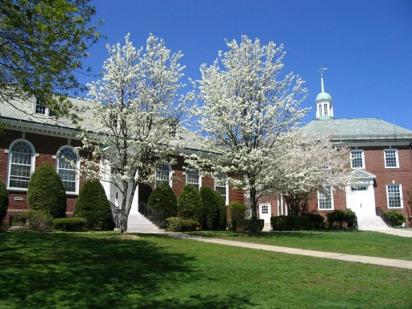
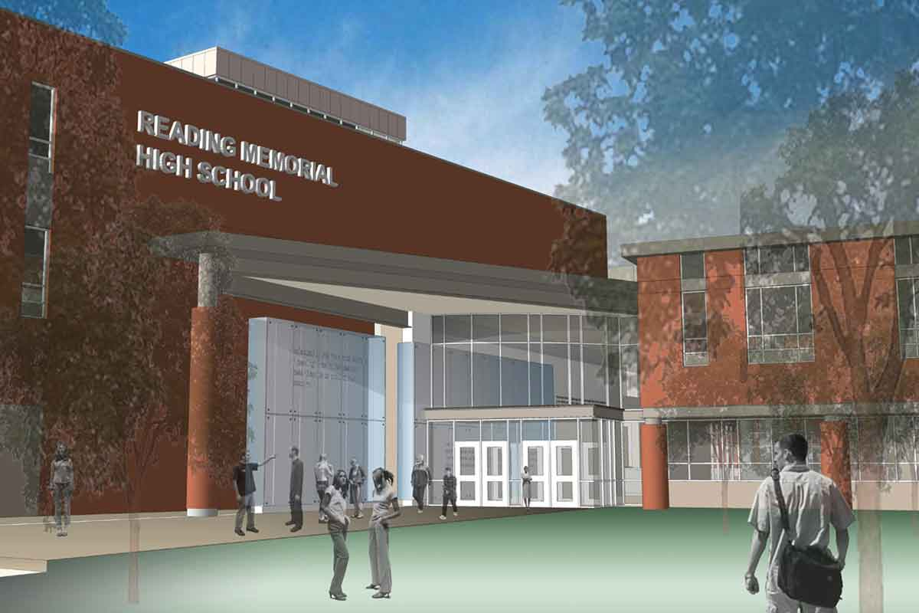
Town of Reading
FY23 Budget
Town Meeting
April 25, 2022

Slide 2
FY23 Budget
Warrant Report Budget votes
Overview pages 42-67 no votes
------------------------------------------------------------------------------------
1. Shared Costs pages 69-77 lines B99 to F99
& 207-217
2. Town Government pages 78-128 lines G91 to M92
3. School Department pages 129-190 line U99
------------------------------------------------------------------------------------
4. Enterprise Funds pages 191-204 lines W99 to Z99

Slide 3
Overview - Reserve Status
April 2022
FREE CASH July 1, 2021 $ 17,730,185
October 2021 TM – Article 9 (450,052)
    April 2022 TM – FY23 budget ( 2,750,000) $ 14,530,133
  GENERAL STABILIZATION FUND $ 1,712,499*
  FINCOM Reserves 200,000
    TOTAL $ 16,442,632
    14.7% of estimated $111.6 million FY23 net available revenue; FINCOM Policy is 7% minimum
  *total excludes funds designated for specific purpose

Slide 4
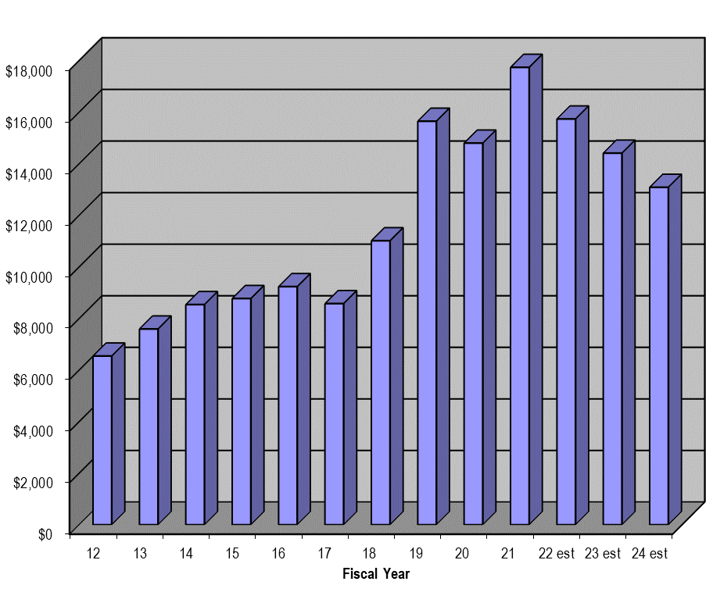
Free Cash
Ten Year Actual History Projected out 3 Years
($ Thousands)
FINCOM Reserve Policy
2022-2024 figures assumes $1.5 million regeneration and $2.75 million in uses in FY22 and $2.5 million in uses in FY23 and FY24.

Slide 5
Regeneration of Reserves
A: Receive more revenues than expected
  Last six years range from +$1.0 mil to +$2.5mil;
  State Aid, new growth and excise taxes vary widely;
  Known one-time variances are purposely ignored in forecast
B: Spend less expenses than budgeted
Average recent sources:
- Town Government 68%
- Schools 12%
- Shared Costs & other 20%
Combination A+B is called ‘regeneration’
$1.5 million assumed minimum – serves as basis for spending that much Free Cash to balance annual budgets

Slide 6
FY23 Projected General Fund Revenues
($ millions)
Pages 62 - 66
 | FY22 | FY23 | Change
Prop Taxes | 81.84 | 84.80 | +3.6%
Local Revs | 7.73 | 7.60 | -1.7%
State Aid | 14.78 | 15.15 | +2.5%
Transfers & Avail | 3.98 | 4.05 | +1.7%
Sub Total | 108.33 | 111.60 | +3.0%
Reserves Used | 2.87 | 2.75 | -4.2%
TOTAL | 111.20 | 114.35 | +2.8%

Slide 7
FY23 Spending Scorecard
($ millions)
Page 67
 | FY22 | FY23 | Change
Shared Costs | 28.43 | 29.79 | +4.8%
Town Gov’t | 31.03 | 32.02 | +3.2%
Schools | 49.70 | 51.78 | +4.2%
General Fund | 109.16 | 113.59 | +4.1%
Water | 7.66 | 8.28 | +8.1%
Sewer | 7.30 | 7.50 | +2.7%
Storm Water | 0.54 | 0. 78 | +46.1%
PEG Access | 0.61 | 0.63 | +2.2%
Landfill | .37 | .37 | +.0.0%
Enterprise Funds | 16.15 | 17.23 | +6.7%
TOTAL | 125.31 | 130.81 | +4.4%

Slide 8
Shared Costs
($ millions)
Pages 69-77
 |  | FY22 | FY23 | Change
B99 | Benefits | $19.11 | $20.08 | +5.1%
C99 | Capital | 3.96 | 2.68 | -32.2%
D99 | Debt | 4.76 | 5.98 | +25.6%
E99 | Vocational Schools | 0.79 | 0.84 | +6.6%
F99 | FINCOM Reserves | 0.20 | 0.20 | 0%
 | Shared Costs | $28.43 | $29.79 | +4.8%
Purposefully high figure for Capital + Debt: extra Free Cash added to fund this so as to not detract from the funding of the Operations of the Schools or Town

Slide 9
FY23 Benefits (Line B99)
($ millions)
Pages 69-71
Employee & Retiree Benefits $20.08 + 5.1%
Retirement $ 6.47 + 13.3%
Pension Assessment 5.93 + 6.5%
OPEB 0.50 +400.0%
Other 0.04 + 0.0%
Medicare $ 1.00 + 0.0%
Health Insurance $ 12.00 + 1.7%
Premiums 11.71 + 1.7%
Other 0.29 + .69%
Worker Compensation $ 0.41 + 2.5%
Indemnification $ 0.13 + 0.0%
Unemployment $ 0.08 + 0.0%

Slide 10
FY23 Capital (C99)
Pages 71-76
Pages 207-217
Proposed Capital spending $2,681,000 -24.9%
$ 62k Permanent Building Committee, RISE playground design
$ 110k School technology projects and phone upgrade
$ 100k Town technology projects
$ 15k School – carpeting/flooring at Parker MS
$ 15k Town Buildings – various doors & window repairs
$ 10k Library –shelving and equipment
$ 25k Playground improvements at Memorial Park
$ 435k PS – replace ambulance, related equip, and fire hoses
$ 925k Road repairs
$ 200k Skim coating, seal crack road repairs & sidewalk repairs
$ 100k Parking lot and fence improvements
$ 100k Rock Wall repairs at Memorial Park
$ 210k Chipper/Loader (2008)
$ 185k Snow holder (2015)
$ 150k Gang lawn mower (2007)
$ 39k Trailer for stump grinder and replacement trailer (1985)
Notes:
10

Slide 11
FY23 Debt (D99)
Pages 76-77
Pages 207-217
Debt Service $5,978,366 +25.7%
debt premiums paid $ 5,175
within levy $3,245,784
School buildings $ 984,115
All buildings - energy $ 857,004
Building security $ 460,300
RMHS Turf II & Turf I $ 602,125
Police Station/Public Health $ 197,939
Roadway Improvements $ 144,300
excluded from the levy $2,732,582
Schools (ends 2024) $1,364,082
Library (ends 2025) $1,368,500
Notes:
11
Short detour about tax bills for perspective

Slide 12
Debt Authorizations

Slide 13
Vocational Education (Line E99)
& FINCOM Reserves (Line F99)
Page 77
Vocational Education $840,000 +6.6%
This figure annually estimates enrollment, and sometimes needs to be amended at a future Town Meeting.
FINCOM Reserves $200,000 +0.0%
- Ends presentation on Shared Costs -
Notes:
This completes the section on shared costs, let’s pause for comments or questions?

Slide 14
Town Government Overview
($millions unless specified)
Page 67 & 78
 | FY22 | FY23 | Changes
Admin Services | 3.41 | 3.64 | +6.9%
Public Services | 1.60 | 1.64 | +2.2%
Finance | 0.95 | 0.99 | +3.9%
Public Safety* | 13.10 | 13.44 | +2.6%
Public Works | 6.49 | 6.66 | +2.7%
Public Library | 1.93 | 2.00 | +3.3%
Facilities | 3.53 | 3.65 | +3.3%
TOTAL | 31.01 | 32.02 | +3.2%

Slide 15
Administrative Services +6.9%
Wages (G91) and Expenses (G92)
Pages 80-86
Wages $1,629,475 (+5.0%) Expenses $2,013,600 (+8.5%)
Wages
$55k increase in elections wages, three elections in FY23 compared with one election in FY22; ~+3.75% increase otherwise
Staffing levels remain unchanged
$6k OT increase in Technology for special projects and night meeting support
Expenses
$85k funding for results of the pay and class study for non-union staff
Elections cost are up due to a tripling of elections in FY23
$15k line item added for the Select Board to allocate funds to their appointed boards and committees.
Partial implementation of Office 365

Slide 16
Public Services +2.3%
Wages (H91) and Expenses (H92)
Pages 87-95
Wages $1,377,150 (+0.1%) Expenses $260,500 (+16.0%)
Wages
Additional hours for some part-time position in Elder and Human Services
Additional hours for part-time Recreation staff
Expenses
Affordable Housing is changed to an outsourced regional agreement, and the salary costs are moved to expenses.
Notes:
16

Slide 17
Finance +3.9%
Wages (I91) and Expenses (I92)
Pages 96-99
Wages $835,050 (+4.2%) Expenses $155,650 (+2.2%)
Wages
Additional hours for Finance part-time support staff
Expenses
Maintain Regional Assessing arrangement with Wakefield
Professional development expenses increased slightly
Increased professional services to update bridge between CAMA and our MUNIS software and for more personal property inspections services

Slide 18
Public Safety +3.2%
Wages (J91) and Expenses (J92)
Pages 100-109
Wages $12, 739,675 (+3.3%) Expenses $703,250 (+1.4%)
Public Health $ 421,325 + 8.5% Pages 101-102
Fire/EMS $5,849,875 + 3.1% Pages 103-104
Police $6,199,500 + 3.2% Pages 105-107
Coalition $ 275,800 + 1.7% Page 108
Dispatch $ 696,425 + 2.9% Page 109
Funding may not move between any of these areas above without the approval of the Town Accountant

Slide 19
Public Health
Pages 101-102
Wages $ 339,825 (+10.7%) Expenses $81,500 (+0.0%)
Wages
New Department Head – Public Health Director
Interim Health Director is removed from this budget
Addition of clerical support staff, as relying on shared Town staff at Town Hall will not be an option once the move to the new office is complete
Expenses
No significant changes

Slide 20
Fire and EMS
Pages 103-104
Wages $5,640,375 (+3.2%) Expenses $209,500 (+1.2%)
Wages
No staffing changes
Expenses
Modest increase in professional development, caused by recent promotions

Slide 21
Police
Pages 105-107
Wages $5,867,500 (+3.2%) Expenses $332,000 (+2.1%)
Wages
No change staffing levels
Additional hours for Parking Enforcement Officer (from 22 hours per week to 32 hours per week)
Expenses
Animal Control Officer is now regionalized
.
Notes:
21

Slide 22
Coalition
Page 108
Wages $234,050 (+2.0%) Expenses $41,750 (+0.0%)
Wages
No change in staffing;
Coalition recently hired the new Mental Health Clinician position.
Expenses
Expenses are level funded to FY22
Notes:
22

Slide 23
Dispatch
Page 109
Wages $657,925 (+3.0%) Expenses $38,500 (+1.3%)
Wages
Grant shown as offset to wages only per Town Accountant
Expenses
Technology expenses increased slightly
Notes:
23

Slide 24
Public Works +2.7% total
Division Wages (K91) and Expenses (K92)
Pages 110-118
Wages $3,010,925 (+4.5%) Expenses $867,200 (-2.9%)
Wages
Full-time staffing remains unchanged
Trust fund continues to pay a portion of Cemetery wages
OT increased by $2k in Engineering due to ongoing emergency water/sewer projects
Expenses
$50k one-time expense for Town Forest Committee in FY22 is removed in FY23
Funding both Trails and Town Forest has been moved to the Select Board budget line
Police Details increased due to ongoing emergency water/sewer projects
Gravel crushing budget increased by $5k to attract vendors to do this work that staff is not equipped to do
Increase funding for shade trees by 23% to expand the variety of trees in Town

Slide 25
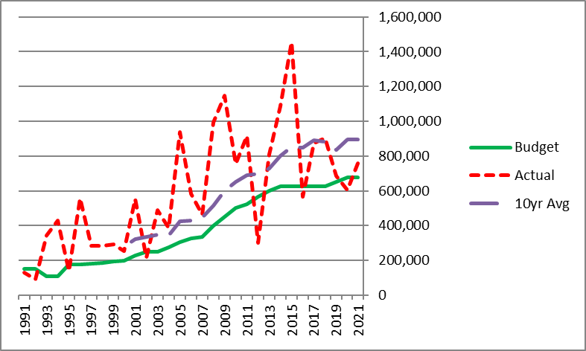
Public Works
Snow & Ice (K93)
Page 118
Snow & Ice funding level funded at $675,000 (+0%)
‘Underfunded’ on purpose: why eliminate teachers & public safety in case we have a light winter (FY12 & FY16 & FY20) ?
Notes:
25

Slide 26
Public Works
Street Lights (K94) and Rubbish (K95)
Page 118
Street Lighting $130,000 (+0.0%)
Costs continue to be modest
Rubbish $1,975,500 (+3.6%)
Rubbish Disposal– long term 5 year contracts expires June 30,2025, +3% increase for FY23
Rubbish and Recycling collection continues to enjoy a 10-year contract at a +3% increase for FY23
Notes:
26

Slide 27
Public Library +3.3%
Wages (L91) and Expenses (L92)
Pages 119-123
Wages $1,596,850 (+3.4%) Expenses $399,450 (+3.1%)
Wages
Non-union wages increase by 2% step and 1.75% COLA
Expenses
Materials budget of 13.5% of the Library budget complies with 13% Municipal Appropriation required to be eligible for State Aid
Rebuilding expenses that have been reduced or level-funded for three years

Slide 28
Facilities +3.3%
CORE Facilities (M91) and Town Buildings (M92)
Pages 124-128
CORE $3,283,600 (+3.1%) Town Bldgs $363,550 (+4.4%)
No change in staffing levels.
HVAC expenses have increased significantly in response to COVID-19, an upgrade to MERV-13 filters was made and changed more frequently.
Custodian salaries increase per a collective bargaining agreements
Increase in expenses is driven by outsourced cleaning services
- Ends presentation on Town Departments -

Slide 29
School Department
Pages
See School Superintendent Recording

Slide 30
Enterprise Funds
Overview
Pages 191-204
The Select Board will hold a Public Hearing to set rates, probably in May 2022
Unexpected water main break on Walker’s Brook revealed issues that need to be repaired along the rest of the road
Significant ongoing capital expenses in Water and Sewer
A modest 4% increase in water usage is assumed which will offset rate increases needed.
Notes:
30

Slide 31
Water Enterprise Fund
(W99)
Pages 191-195
Rates estimated at +0.0 to + 8.9 % (Select Board Hearing upcoming)
Wages +4.9% (OT is increased to prepare for unexpected leaks at Walker’s Brook)
Overhead expenses -2.3%
Operating expenses +29.7% (+$100k Outsourced professional service in case a water main break happens that the local crew cannot handle.)
Support to general fund costs +3.9%
Capital & Debt planned at -21.9%
= Total Local costs - 11.7%
MWRA assessment -1.2%
= Gross budget -8.6%
Use $750k Reserves to minimize rates (estimated pending Hearing)
= Net budget 9.9%
Request to use $1 million in ARPA funds to stabilize the rate
Notes:
31

Slide 32
Sewer Enterprise Fund
(X99)
Pages 196-198
Rates estimated at +1.8% (Select Board Hearing upcoming)
Wages +3.6%
Overhead expenses +16.1% (+25K Retirement Assessment )
Operating expenses +1.1%
Support to general fund costs +3.9%
Capital & Debt planned at -3.7%
= Total Local costs +.8%
MWRA assessment +.4%
= Gross budget +.5%
Use $350k Reserves to minimize rates (estimated pending Hearing)
= Net budget +7.2%
-> Increased usage means needed rates are lower
Notes:
32

Slide 33
Storm Water Enterprise Fund
(Y99)
Pages 199-201
Rates estimated as $60/residential SF home (unchanged, SB Hearing)
Wages 28.5% no changes in staffing- wages reflect moving up in experience and qualifications
Overhead expenses +0.0%
Operating expenses +0.0%
Support to general fund costs +3.9%
Capital & Debt planned at +72.4% (+$300k drainage project Memorial Park)
= Total Local costs +39.2%
Use $300k Reserves to offset some capital costs (estimated pending Hearing)
= Net budget +7.4%
FUTURE
=> FY24 Draining Master Plan for the community
=> FY24 Annual drainage fundi9ng is increased by $200k to carry out prioritized findings of the Draining Master Plan

Slide 34
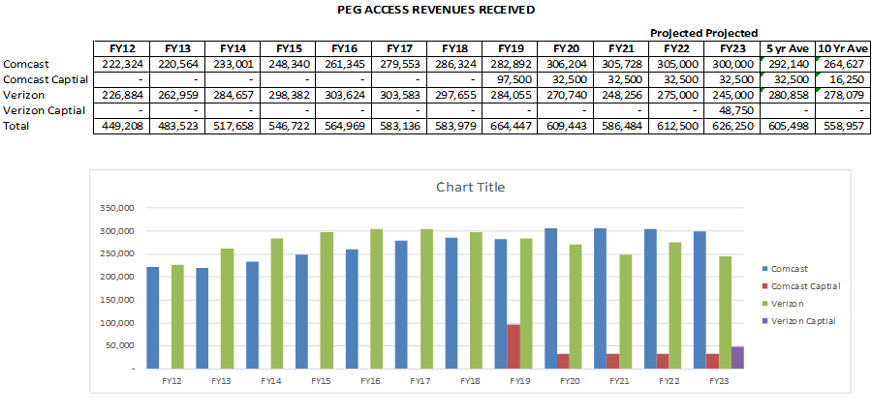
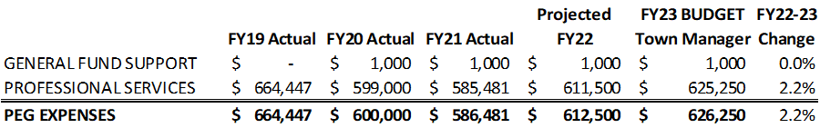
PEG Access Enterprise Fund
(Z99)
Page 202
PEG Access $626,250

Slide 35
Landfill Enterprise Fund
(ZZ9)
Pages 203-204
Landfill $37,000
The Landfill Enterprise fund was created on December 9, 2002, to establish a financial assurance mechanism per the DEP requirements relative to the closure of the Landfill and the post-closure maintenance and monitoring.
The Developer is required to provide monitoring of the Landfill up to and including the limit of $40,000 per year, with a 3% cost of living factor applied each year.
The Town’s obligation is escalated for amounts above $40k per year appropriately escalated.
The Town hasn’t had an obligation relative to the Landfill monitoring since December 2011.
Each January the Developer provides a $37k performance deposit and the Town reimburses the Developer from this deposit when proof of monitoring is provided. DOR would like this $37k appropriated each year going forward.

Slide 36
Budget Motion
Move that the Town appropriate the sum of: $130,811,410 for the operation of the Town and its Government for Fiscal Year 2023, beginning July 1, 2022, with the amount appropriated to be raised as set forth below.
-FINCOM

Slide 37
Amended Budget Motion
Move that the Town appropriate the sum of: $130,506,410* for the operation of the Town and its Government for Fiscal Year 2022, beginning July 1, 2022, with the amount appropriated to be raised as set forth below.
-FINCOM
*Total is corrected for basic Town Manager math errors only in the Enterprise Funds. Incorrect figure was listed as $130,811,410.

